Slide 1
7+1 Visual Storytelling Strategies
Industry Best Practices
Yoda Learning Solutions

Slide 2
8 Storytelling Strategies *
Highlighter (dashed outline)
No. pointers
Key Takeaways & Narratives – Inference, Context, Comparisons & Precedents
Clustering using curly braces shape (75%:25%)
De-Highlighter (white tracing paper) – semi-transparent; Grey Text
Callouts (Annotations)
Symbols (Webdings, Wingdings):
Level of Risk, Criticality, % completion
Legends
Create custom visuals & infographics (to be discussed separately _Part 2)
1
Highlight the insightful or “I see!” zones
*Note: These 8 strategies are not listed on the Internet (book, blog, video). Yoda Learning Solutions R&D team went through 100s of industry reports to filter out these 8 strategies. YouTube Link (Hindi) - https://youtu.be/ehQ7Epo8D6w

Slide 3
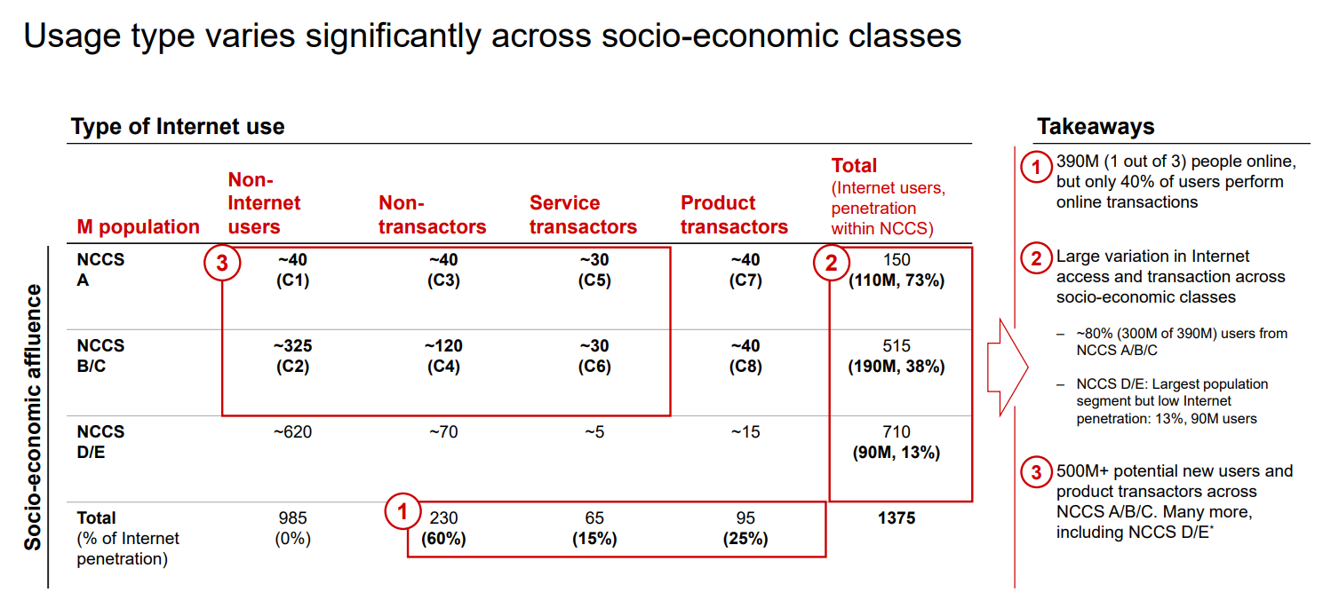
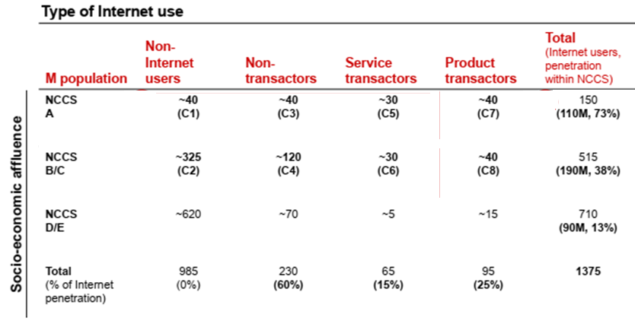
Before
Source: Bain & Co. report

Slide 4
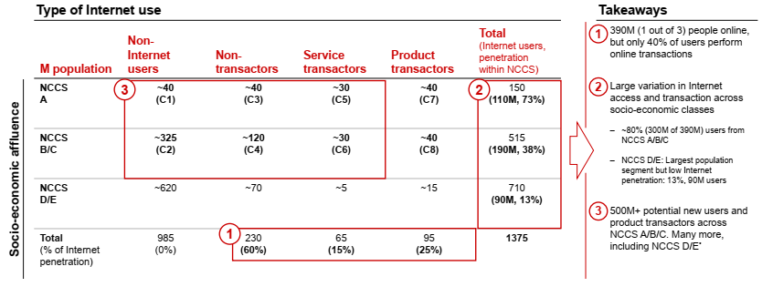
After = Number Pointers + Highlighter + Key Takeaways
Source: Bain & Co. report

Slide 5
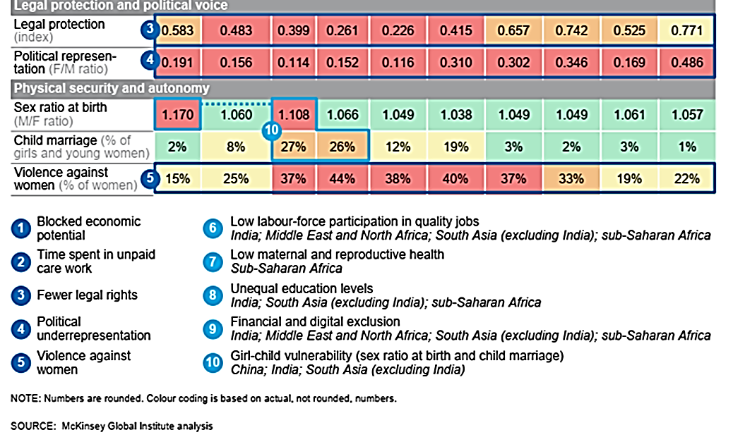
Number Pointers + Highlighter
Source: McKinsey report - MGI India parity_Full report_November 2015

Slide 6
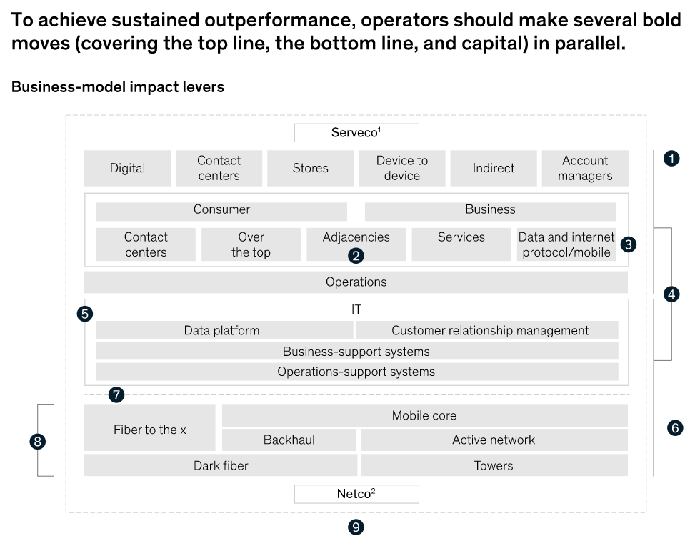
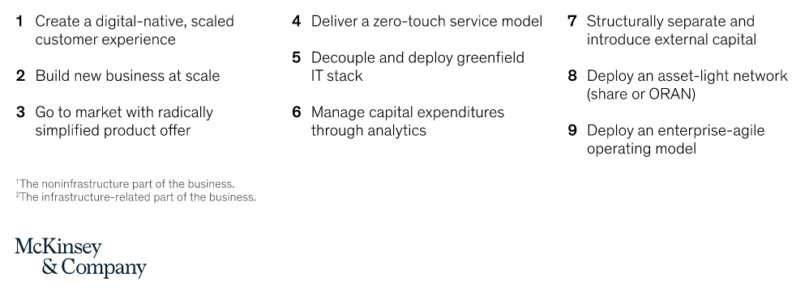
Number Pointer for Process Flow diagrams
Source: McKinsey

Slide 7
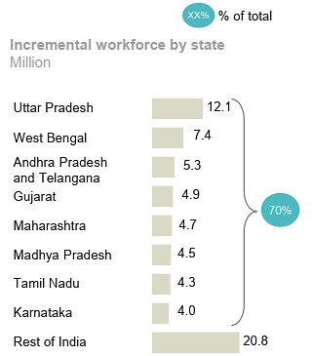
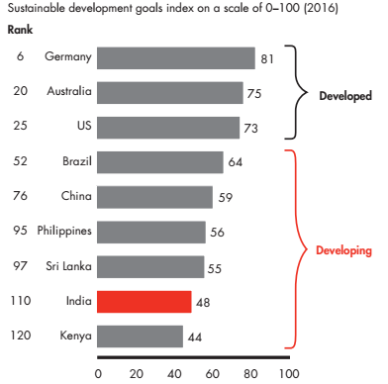
Clustering
Source: McKinsey report - MGI India parity_Full report_November 2015
Source: Bain & Co. report

Slide 8
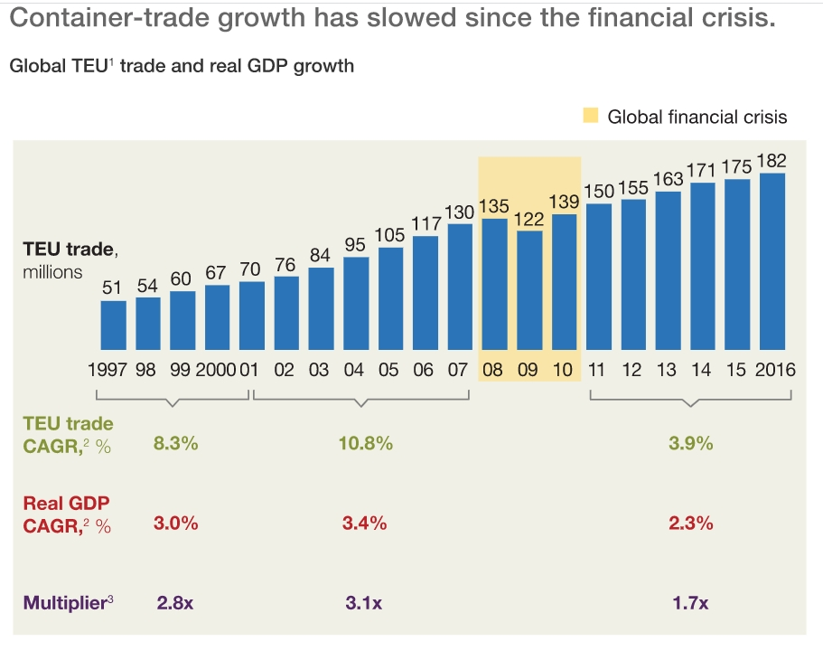
Clustering & Semi-Transparent Highlighter

Slide 9
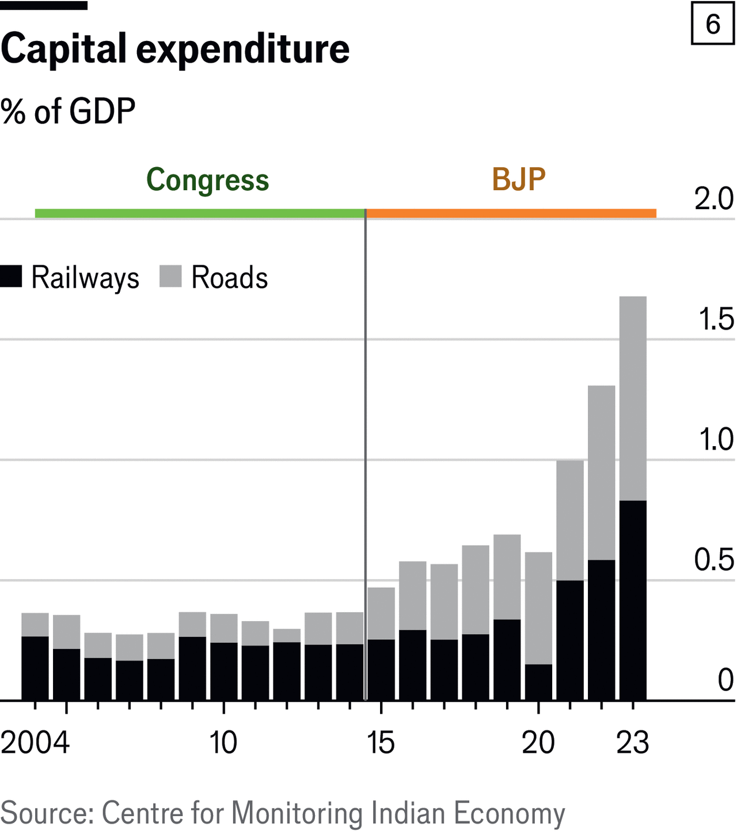
Clustering
Image Source: The Economist
Disclaimer: This is for educational purposes only.

Slide 10
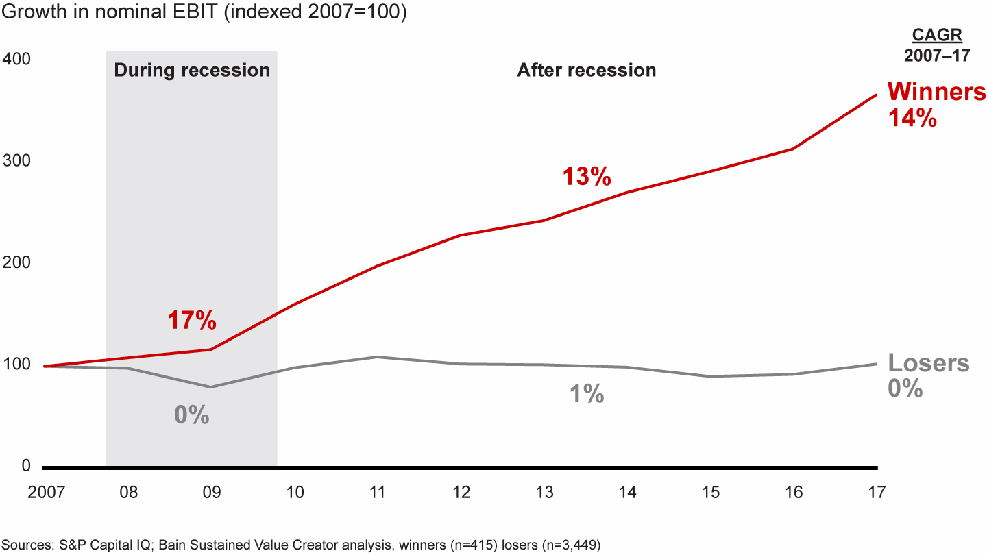
Semi-Transparent Highlighter
Winning companies accelerated profitability during and after the recession, while losers stalled

Slide 11
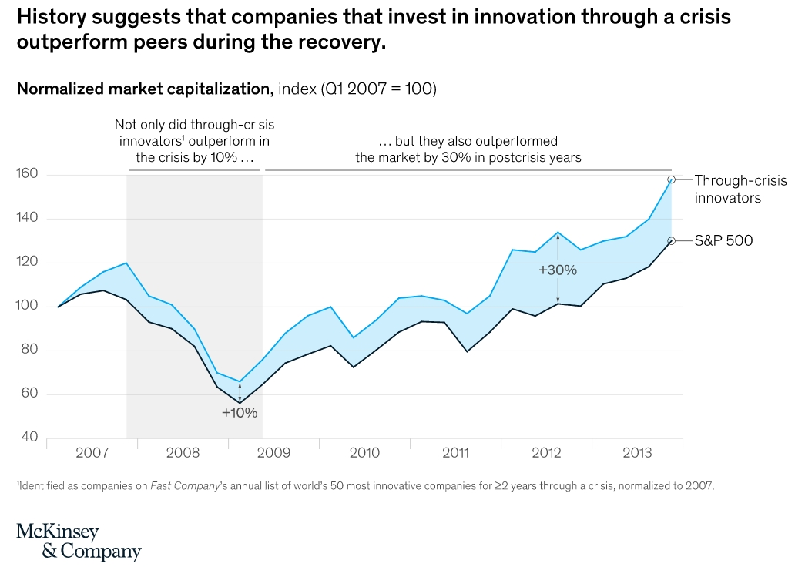
Semi-Transparent Highlighter

Slide 12
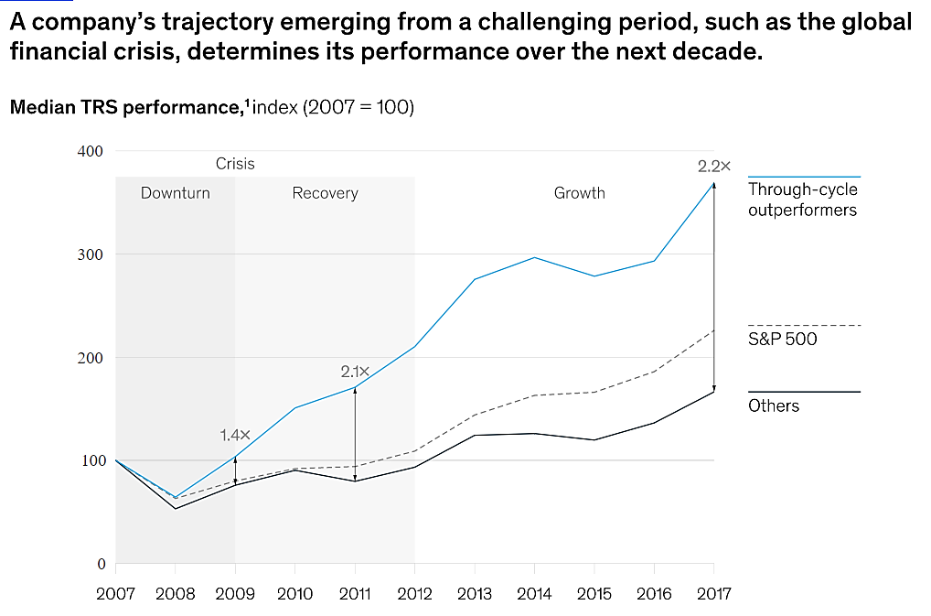
Semi-Transparent Highlighter

Slide 13
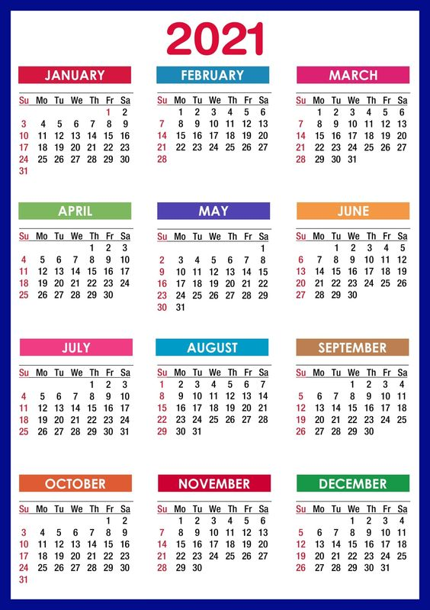
Semi-Transparent Highlighter on a Calendar
Plan of action – remember A of SCQA

Slide 14
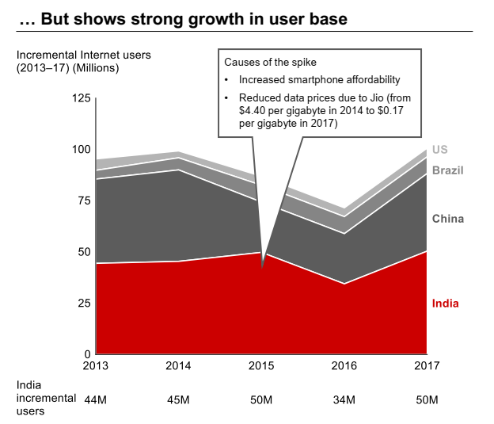
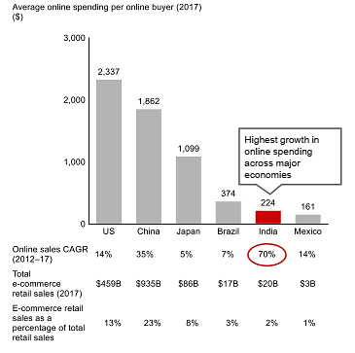
Callouts
Source: Bain & Co. report - reports

Slide 15
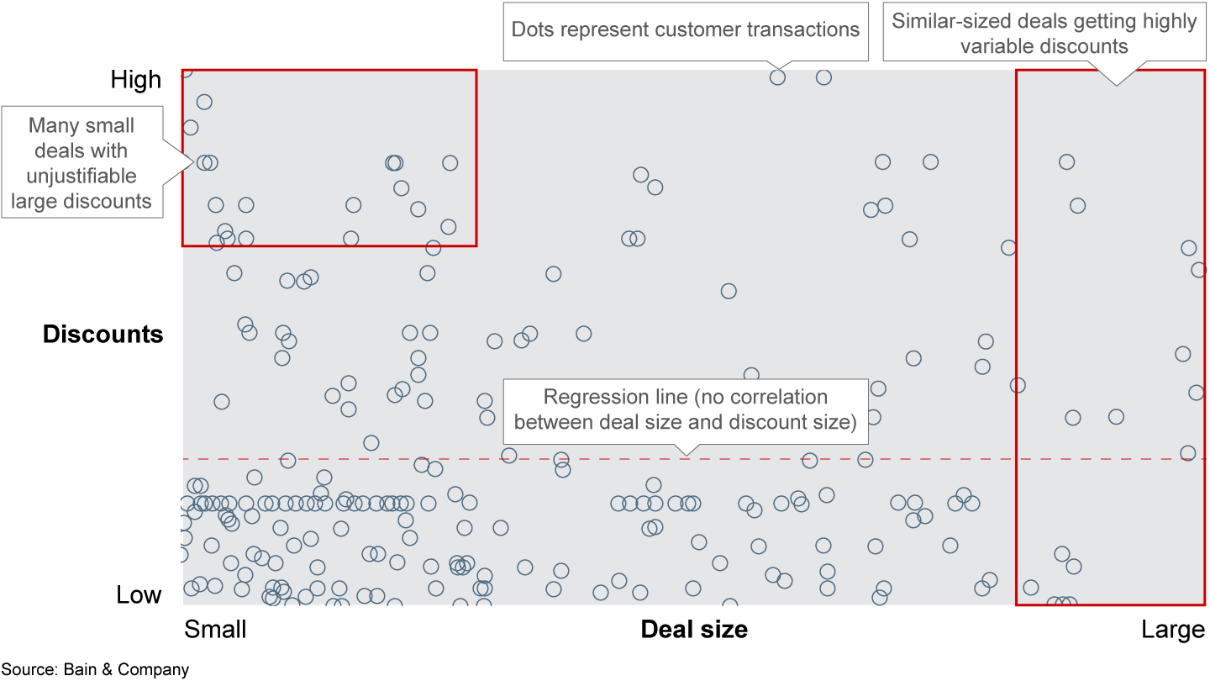
Callouts & Highlighters
Source: Bain & Co. report - reports

Slide 16
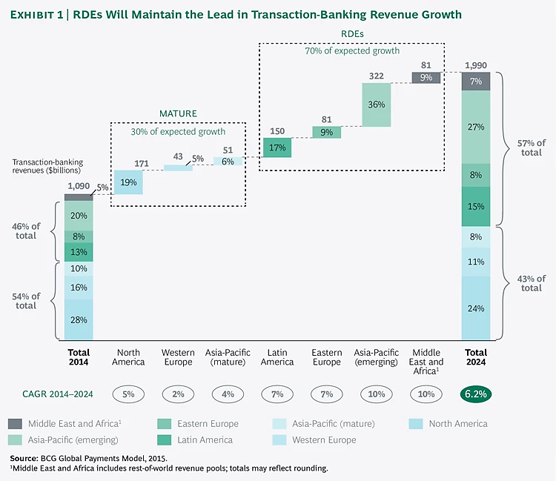
Which Visual Storytelling Strategies have been used?
Image Source: BCG

Slide 17
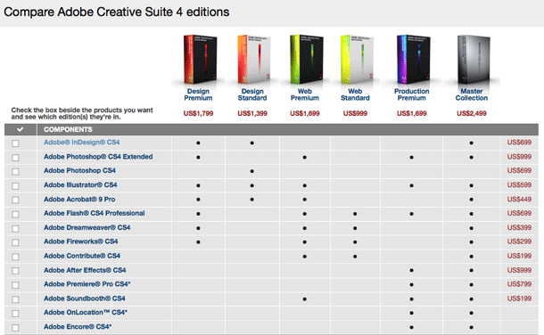
Symbols: Comparing differences (law, solutions)
Parameters for comparison

Slide 18
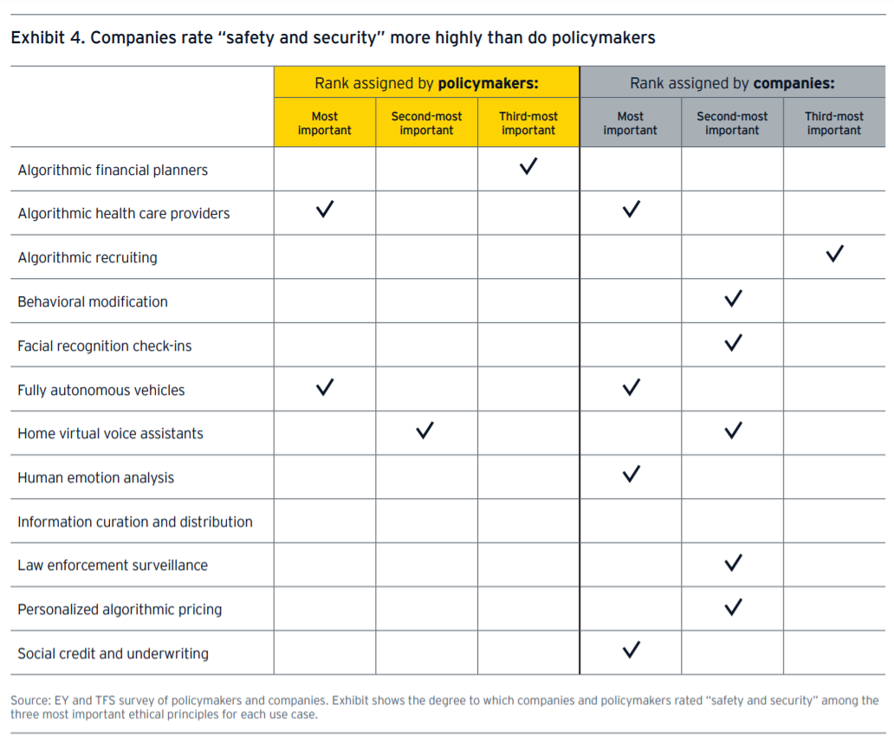

Symbols NEED a table cell or a text box or a shape
Status | #1 | #2 | #3
Very High |  | ❐ | ☑
Very High |  | ❑
Low |  | ❐ | ☑
Very Low |  | ❐ | ☑
Moderate |  | 

Very Low

Very High
Fonts - Wingdings, Webdings, Arial
Source: EY reports

Slide 19
Stitching them all together into - Key Takeaways & Narratives

Slide 20
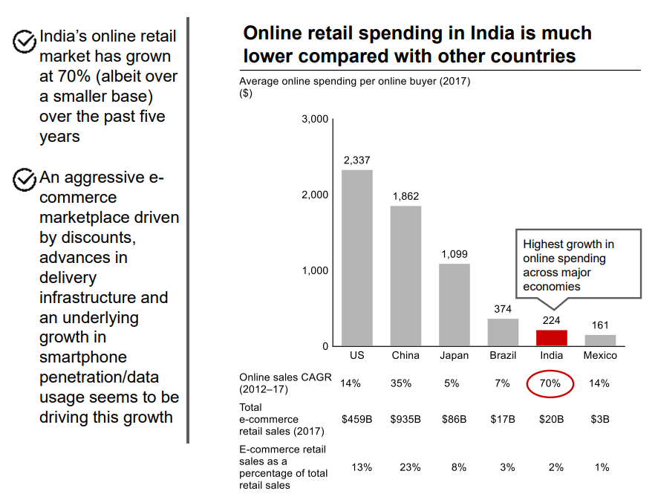
Key Takeaways & Narratives – Inference, Context, Comparisons & Precedents
Key Takeaways – Inference
Key Takeaways – Comparisons / Precedents
Key Takeaways – Context
Source: Bain (2017-18 report)
Notes:
Source: https://www.bain.com/contentassets/8474904b23a54369ada6d628ce8f44bd/report_unlocking_digital_for_bharat.pdf

Slide 21
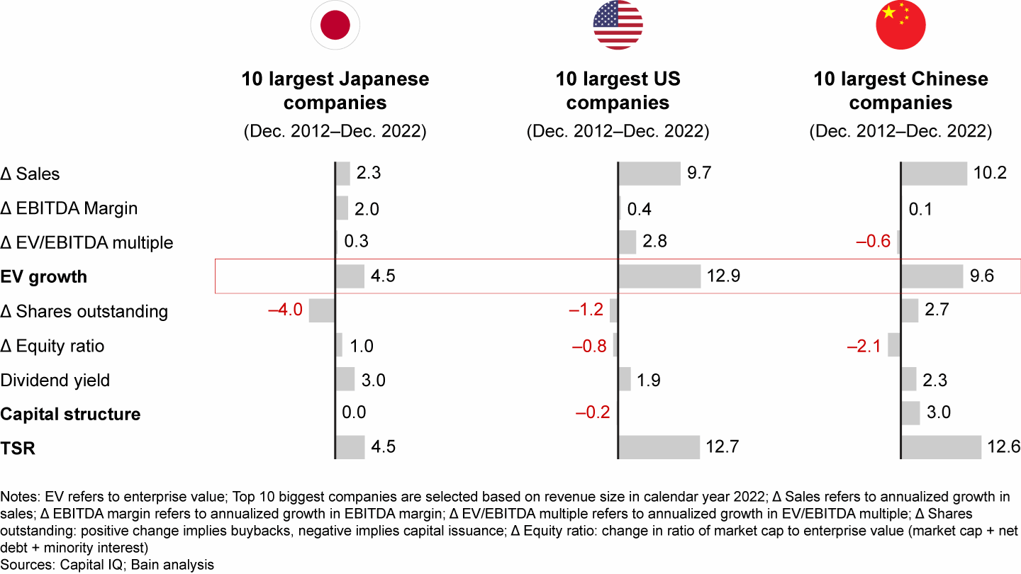
[Narrative] Comparisons = powerful narratives. It sets the context.
Source: Bain & Co. reports
Notes:
Source: https://www.bain.com/insights/pricing-global-private-equity-report-2020/

Slide 22
[Narrative] Comparisons = powerful narratives. It sets the context.
Notes:
Source: https://www.bain.com/insights/pricing-global-private-equity-report-2020/

Slide 23
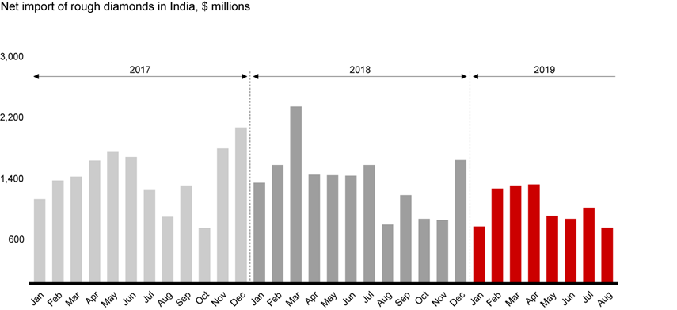
What’s the narrative?
Source: Bain & Co. reports

Slide 24
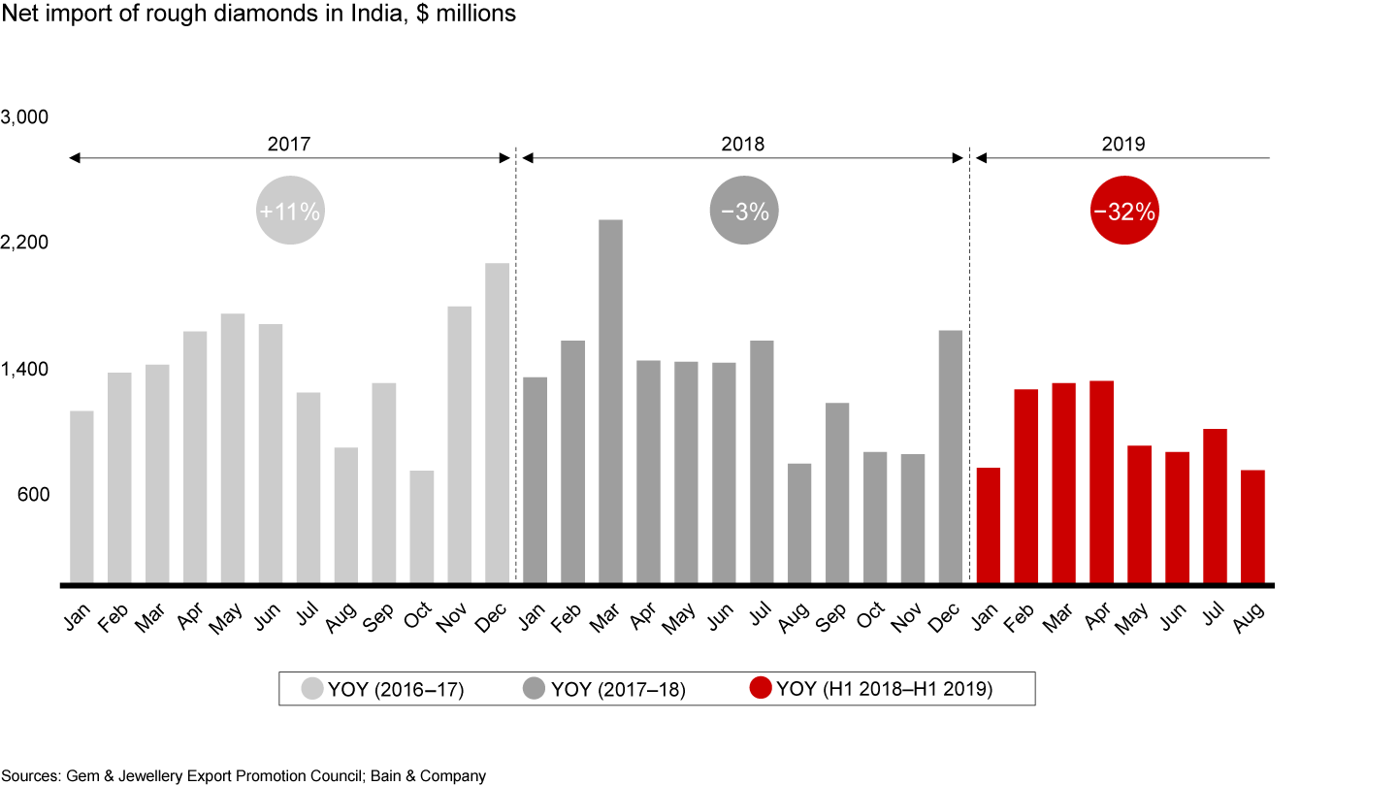
What’s the narrative? (…cont’d)
In India, net imports of rough diamonds decreased 3% in 2018 and 32% in the first eight months of 2019
Source: Bain & Co. reports

Slide 25
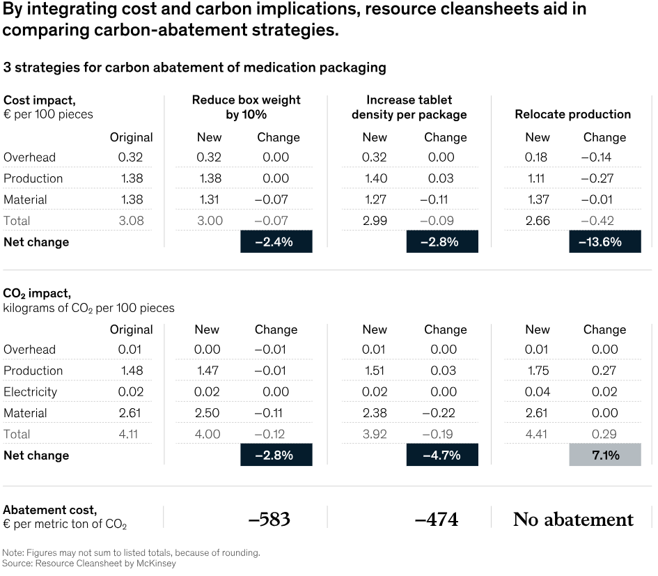
[Narrative] What-If analysis is another form of Comparison
Notes:
Source: https://www.mckinsey.com/capabilities/operations/our-insights/buying-into-a-more-sustainable-value-chain
An abatement cost is a cost borne by firms when they are required to remove and/or reduce undesirable nuisances or negative byproducts created during production.

Slide 26
End

Slide 27
Annexure – for Self-reference

Slide 28
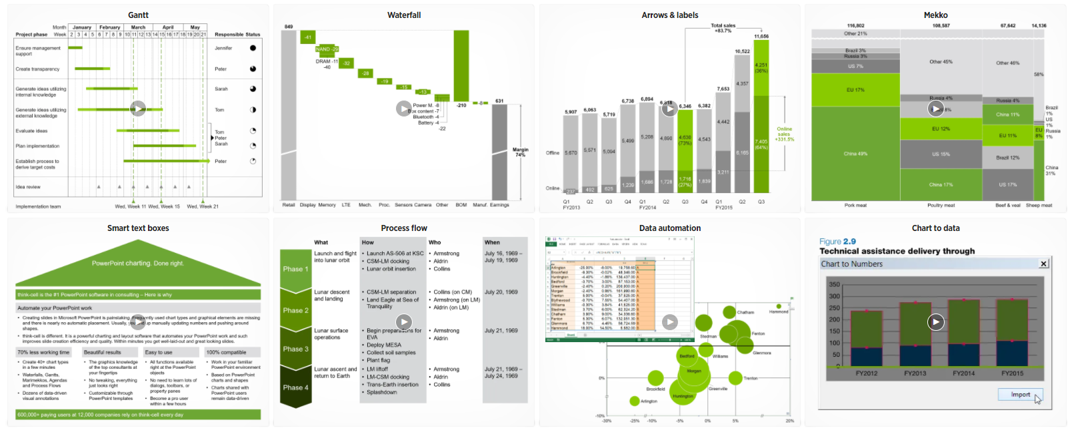
Refer EY app store (www.think-cell.com)

Slide 29
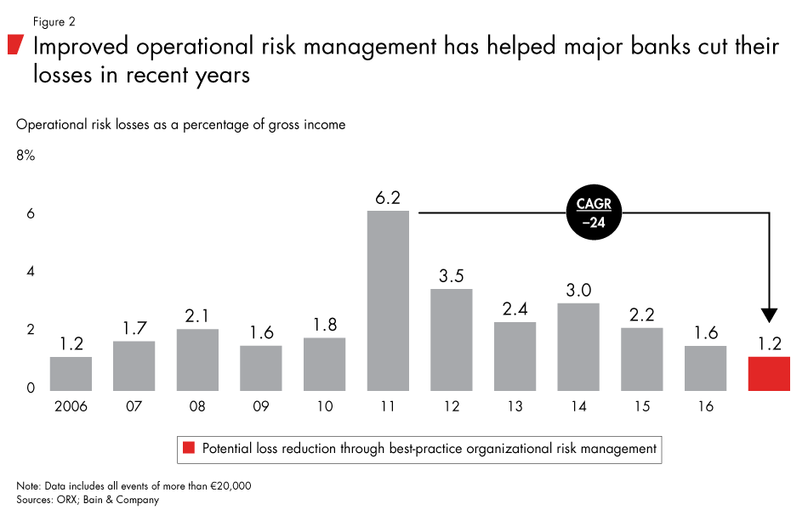
Use Cases of Think-Cell Add-in

Slide 30
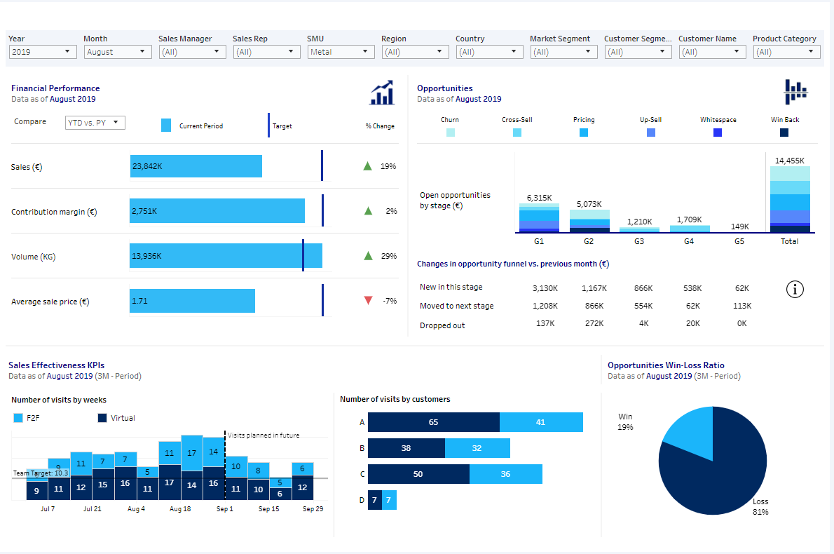
Source: McKinsey reports
Notes:
Source: https://www.mckinsey.com/capabilities/growth-marketing-and-sales/our-insights/insights-to-impact-creating-and-sustaining-data-driven-commercial-growth
Such a dashboard serves as the “single source of truth” on commercial performance, consolidating indicators on current financial performance, the potential value of future opportunities, and sales effectiveness (Exhibit 2).
The interactive tool combines granular financials with pricing opportunities and funnel progress. It allows teams to filter the data as needed, thereby providing transparency at the team, individual sales-rep, or even customer level.
Also, refer –
https://www.mckinsey.com/capabilities/growth-marketing-and-sales/our-insights/commercial-performance-cockpit-a-new-era-for-data-driven-steering
https://www.mckinsey.com/~/media/mckinsey/business%20functions/marketing%20and%20sales/our%20insights/commercial%20performance%20cockpit%20a%20new%20era%20for%20data%20driven%20steering/svg-commercial-performance-exhibit-3-v1.svgz?cq=50&cpy=Center

Slide 31

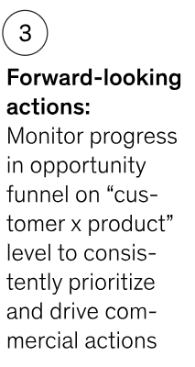
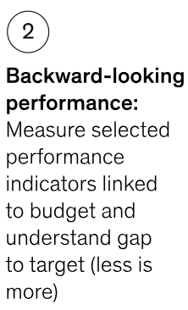
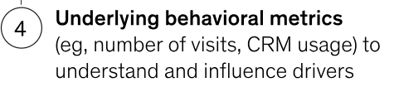
Source: McKinsey reports
Notes:
Source: https://www.mckinsey.com/capabilities/growth-marketing-and-sales/our-insights/insights-to-impact-creating-and-sustaining-data-driven-commercial-growth
Such a dashboard serves as the “single source of truth” on commercial performance, consolidating indicators on current financial performance, the potential value of future opportunities, and sales effectiveness (Exhibit 2).
The interactive tool combines granular financials with pricing opportunities and funnel progress. It allows teams to filter the data as needed, thereby providing transparency at the team, individual sales-rep, or even customer level.
Also, refer –
https://www.mckinsey.com/capabilities/growth-marketing-and-sales/our-insights/commercial-performance-cockpit-a-new-era-for-data-driven-steering
https://www.mckinsey.com/~/media/mckinsey/business%20functions/marketing%20and%20sales/our%20insights/commercial%20performance%20cockpit%20a%20new%20era%20for%20data%20driven%20steering/svg-commercial-performance-exhibit-3-v1.svgz?cq=50&cpy=Center

Slide 32
Table 1 (Before)
ISD Spend from 5 cities is ~84% of total office voice expenses
# | City | ISD | STD | Local | Total | % of total
1 | Pune | 80,897 | 591 | 1,373 | 82,861 | 40%
2 | Hyderabad | 41,486 | 1,615 | 1,640 | 44,742 | 22%
3 | Chennai | 18,956 | 1,923 | 1,459 | 22,338 | 11%
4 | Noida | 15,086 | 771 | 607 | 16,464 | 8%
5 | Bangalore | 15,736 | - | - | 15,736 | 8%
6 | Kolkata | 9,573 | 20 | 19 | 9,611 | 5%
7 | Mumbai | 8,986 | 1 | 25 | 9,012 | 4%
8 | Chandigarh | 3,556 | 5 | 2 | 3,563 | 2%
9 | Bhubneshwar | 285 | - | - | 285 | 0%
10 | Ahmedabad | 20 | 30 | 45 | 94 | 0%
 | Total | 1,94,582 | 4,955 | 5,169 | 2,04,706 | 100%
 |  | 95% | 2% | 3% | 100%
Data Source: EY Team
Before

Slide 33
Table 2 (After)
ISD Spend from 5 cities is ~84% of total office voice expenses
2
# | City | ISD | STD | Local | Total | % of total
1 | Pune | 80,897 | 591 | 1,373 | 82,861 | 40%
2 | Hyderabad | 41,486 | 1,615 | 1,640 | 44,742 | 22%
3 | Chennai | 18,956 | 1,923 | 1,459 | 22,338 | 11%
4 | Noida | 15,086 | 771 | 607 | 16,464 | 8%
5 | Bangalore | 15,736 | - | - | 15,736 | 8%
6 | Kolkata | 9,573 | 20 | 19 | 9,611 | 5%
7 | Mumbai | 8,986 | 1 | 25 | 9,012 | 4%
8 | Chandigarh | 3,556 | 5 | 2 | 3,563 | 2%
9 | Bhubneshwar | 285 | - | - | 285 | 0%
10 | Ahmedabad | 20 | 30 | 45 | 94 | 0%
 | Total | 1,94,582 | 4,955 | 5,169 | 2,04,706 | 100%
 |  | 95% | 2% | 3% | 100%
1
Pune, Hyderabad & Chennai account for 73% of total office voice expenses
2
ISD Spend from 5 cities is ~84% of total office voice expenses
Data Source: EY Team
After #1

Slide 34
Table 3 (After)
ISD Spend from 5 cities is ~84% of total office voice expenses
# | City | ISD | STD | Local | Total | % of total
1 | Pune | 80,897 | 591 | 1,373 | 82,861 | 40%
2 | Hyderabad | 41,486 | 1,615 | 1,640 | 44,742 | 22%
3 | Chennai | 18,956 | 1,923 | 1,459 | 22,338 | 11%
4 | Noida | 15,086 | 771 | 607 | 16,464 | 8%
5 | Bangalore | 15,736 | - | - | 15,736 | 8%
6 | Kolkata | 9,573 | 20 | 19 | 9,611 | 5%
7 | Mumbai | 8,986 | 1 | 25 | 9,012 | 4%
8 | Chandigarh | 3,556 | 5 | 2 | 3,563 | 2%
9 | Bhubneshwar | 285 | - | - | 285 | 0%
10 | Ahmedabad | 20 | 30 | 45 | 94 | 0%
 | Total | 1,94,582 | 4,955 | 5,169 | 2,04,706 | 100%
 |  | 95% | 2% | 3% | 100%
73%
27%
Data Source: EY Team
After #2

Slide 35
Table 4 (After) – with de-highlighter
ISD Spend from 5 cities is ~84% of total office voice expenses
# | City | ISD | STD | Local | Total | % of total
1 | Pune | 80,897 | 591 | 1,373 | 82,861 | 40%
2 | Hyderabad | 41,486 | 1,615 | 1,640 | 44,742 | 22%
3 | Chennai | 18,956 | 1,923 | 1,459 | 22,338 | 11%
4 | Noida | 15,086 | 771 | 607 | 16,464 | 8%
5 | Bangalore | 15,736 | - | - | 15,736 | 8%
6 | Kolkata | 9,573 | 20 | 19 | 9,611 | 5%
7 | Mumbai | 8,986 | 1 | 25 | 9,012 | 4%
8 | Chandigarh | 3,556 | 5 | 2 | 3,563 | 2%
9 | Bhubneshwar | 285 | - | - | 285 | 0%
10 | Ahmedabad | 20 | 30 | 45 | 94 | 0%
 | Total | 1,94,582 | 4,955 | 5,169 | 2,04,706 | 100%
 |  | 95% | 2% | 3% | 100%
ISD Spend from 5 cities is ~84% of total office voice expenses
Data Source: EY Team
After #3

Slide 36
Table 4 (After) – without de-highlighter
ISD Spend from 5 cities is ~84% of total office voice expenses
# | City | ISD | STD | Local | Total | % of total
1 | Pune | 80,897 | 591 | 1,373 | 82,861 | 40%
2 | Hyderabad | 41,486 | 1,615 | 1,640 | 44,742 | 22%
3 | Chennai | 18,956 | 1,923 | 1,459 | 22,338 | 11%
4 | Noida | 15,086 | 771 | 607 | 16,464 | 8%
5 | Bangalore | 15,736 | - | - | 15,736 | 8%
6 | Kolkata | 9,573 | 20 | 19 | 9,611 | 5%
7 | Mumbai | 8,986 | 1 | 25 | 9,012 | 4%
8 | Chandigarh | 3,556 | 5 | 2 | 3,563 | 2%
9 | Bhubneshwar | 285 | - | - | 285 | 0%
10 | Ahmedabad | 20 | 30 | 45 | 94 | 0%
 | Total | 1,94,582 | 4,955 | 5,169 | 2,04,706 | 100%
 |  | 95% | 2% | 3% | 100%
ISD Spend from 5 cities is ~84% of total office voice expenses
Data Source: EY Team
After #3

Slide 37
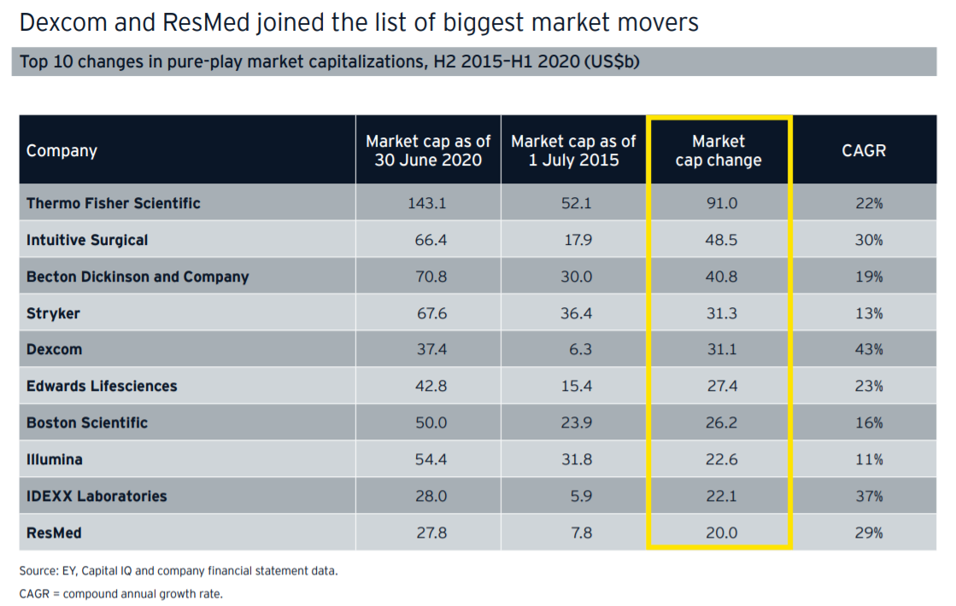
Highlighter

Slide 38
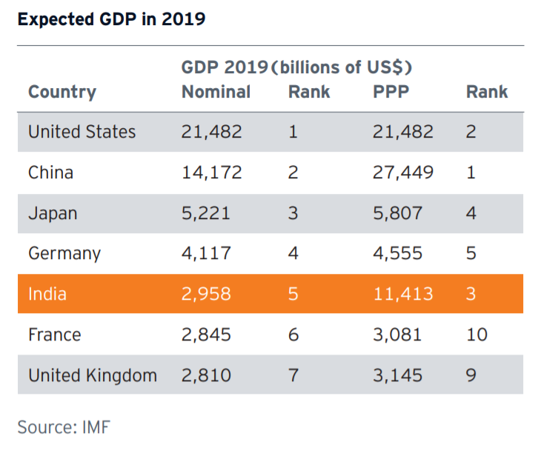
Highlighter-effect (Banded Row)
Notes:
Source: ey-how-a-billion-screens-can-turn-india-into-a-m-and-e-powerhouse.pdf

Slide 39
Practice Area
 | #1 | #3 | #3
Very High |  | ❐ | ☑
Very High |  | ❑
Low |  | ❐ | ☑
Very Low |  | ❐ | ☑
Moderate |  | 
Low |  | ❐ | ☑
Low |  | ❐ | ☑
79%
1

Slide 40
How will you make this visually easy to read?
 |  | Very High
 |  | Very High
 |  | Low
 |  | Very Low
 |  | Moderate

Slide 41
How will you make this visually easy to read?
 |  | 
 |  | 
 |  | 
 |  | 
 |  | 
Note: Font Wingdings are better than Shapes as the latter don’t get “grouped” with the Table

Slide 42
How will you de-clutter the Table from repetitive names?
 |  |  | Entities
A |  |  | Ernst & Young Global Limited (UK), Ernst and Young LLP (India), Ernst & Young (Sweden)
B |  |  | Ernst and Young LLP (India), Ernst & Young (Sweden)
C
D
E

Slide 43
… by using Legends
 |  |  | Entities
A |  |  | ❶❷❸
B |  |  | ❷❸
C
D
E
❶ Ernst & Young Global Limited (UK)
❸ Ernst and Young (Sweden)
❷ Ernst and Young LLP (India)

Slide 44
More examples of symbols
 |  |  |  |  | #1 | #2
 |  |  |  |  | ❐ | ☑
 |  |  |  |  | ❑
 |  |  |  |  | ❐ | ☑
 |  |  |  |  | ❐ | ☑
 |  |  |  |  | 

Slide 45
Highlighter: Narrowing down choices to a single recommendation

Slide 46
De-Highlighter: Striking-off some options / irrelevant data
 |  | A | B | C | D | E
 |  | A | B | C | D | E

Slide 47
How do you make this easy to read for the decision makers?
 |  |  |  |  |  | Orders
 |  |  |  |  |  | 215
 |  |  |  |  |  | 98
 |  |  |  |  |  | 33
 |  |  |  |  |  | 22
 |  |  |  |  |  | 12
 |  |  |  |  |  | 11
 |  |  |  |  |  | 7

Slide 48
… by using Clustering based on % of Total
 |  |  |  |  |  | Orders
 |  |  |  |  |  | 215
 |  |  |  |  |  | 98
 |  |  |  |  |  | 33
 |  |  |  |  |  | 22
 |  |  |  |  |  | 12
 |  |  |  |  |  | 11
 |  |  |  |  |  | 7
79%
21%

Slide 49
… by using Clustering based on Category
US$
INR

Slide 50
How do you control the flow of reading AND make a Table look less text heavy?
 |  |  |  |  | #1 | #2
 |  |  |  |  | 21 | 15
 |  |  |  |  | 22 | 65
 |  |  |  |  | 78 | 233
 |  |  |  |  | 123 | 12
 |  |  |  |  | 78 | 212
 |  |  |  |  | 12 | 11

Slide 51
… using No. Pointers
 |  |  |  |  | #1 | #2
 |  |  |  |  | 21 | 15
 |  |  |  |  | 22 | 65
 |  |  |  |  | 78 | 233
 |  |  |  |  | 123 | 12
 |  |  |  |  | 78 | 212
 |  |  |  |  | 12 | 11
1
2
1
Explanation 1: __________________
2
Explanation 2: __________________

Slide 52
.. or using BOTH No. Pointers + Highlighter
 |  |  |  |  | #1 | #2
 |  |  |  |  | 21 | 15
 |  |  |  |  | 22 | 65
 |  |  |  |  | 78 | 233
 |  |  |  |  | 123 | 12
 |  |  |  |  | 78 | 212
 |  |  |  |  | 12 | 11
1
2
1
Explanation 1: __________________
2
Explanation 2: __________________

Slide 53
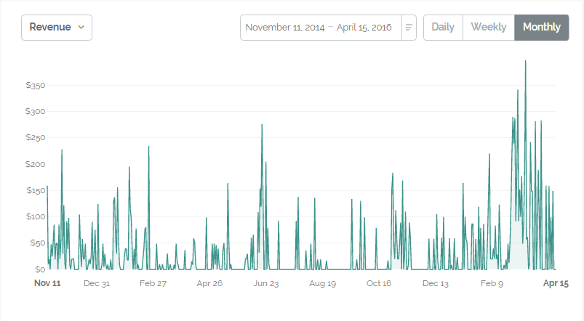

Slide 54
❸
Highest Sales till-date
Festive Sales
❶
Cashback
Festive Sales
❷
❶
210% 
❐
CRM Go-LIVE
Sporadic Sales due to festive discounts and cashbacks
Discount withdrawn

